Slide 1
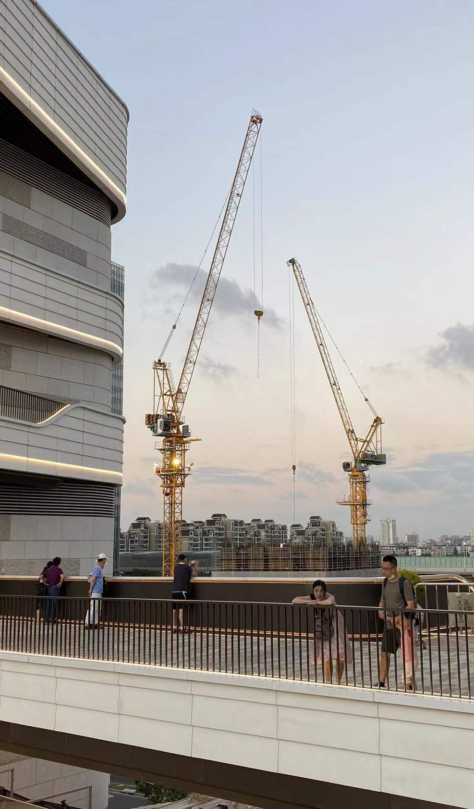
Identifying shopping centers with high operating loss risk and redevelopment value
Final Presentation
Chi Zhang
MUSA, 2022

Slide 2
Background
The booming of shopping centers and the climbing vacancy rate in Shanghai indicate an over-supply commercial real estate market.
Notes:
As we can see from the two charts below. The booming of shopping centers and the climbing vacancy rate in Shanghai indicates an oversupplied commercial real estate market.

Slide 3
Literature review
Y. Chen and H. Weng, “Lots of Shopping Malls Have to Delay Their Opening Date in Hangzhou,” Daily Business (January 29, 2015).
Y. Li, “Three Commercial Complexes Closed in the Past Half Year in Foushan,” Southcn (May 22, 2015)
L. Zhang, “The Development Upsurge in Foushan,” Real Estate Guide 4 (2013) 87–89
Ghysels, Eric, Alberto Plazzi, and Rossen Valkanov. "Valuation in US commercial real estate." European Financial Management 13.3 (2007): 472-497.
Frew, James, and Beth Wilson. "Estimating the connection between location and property value." Journal of Real estate practice and education 5.1 (2002): 17-25.
Studies and media reports noted the closing risk in an over-supply market
Operation income and location are two major real estate valuation metrics
Since most of the operation data is business secret, how can we quantify the loss risk with accessible datasets?
Notes:
In Shanghai, the number of shopping centers is booming and the vacancy rate increases recent year. Since the market is oversupplied and competitive. There is high operating loss risk and follows with mismatch of operation and location value. Since most of operation data is business secret, how can we quantify two questions above with accessible dataset and perhaps foresee the risk before construction?

Slide 4





Goals and values
From the perspective of researchers, government and investors
2
Goals
3
Values
Researchers: Creative application of gravity model
Government: Land use planning and urban regeneration adjustments
Investors: Risk evaluation and seize redevelopment opportunities
Finding out shopping centers with operating loss risk with gravity model and real estate finance formulas. The results are tested with social media data.
Analyzing mismatch of operation and location value with entropy weight method and regression model

Slide 5
Data
Multivariate data resources are involved to build the model
Category | Resource | Column | Type
Shopping Centers | Wrangled from Yingshang.com | building_area | float
 |  | rentable_area | float
 |  | built_year | integer
 | Baidu Map API | coordinate | geometry
Socioeconomics | Chinese socioeconomical year book of (2020) | population | integer
 |  | disposable_income | integer
 |  | consumption expense | integer
Urban Environment | Purchased from third party | road | geometry
 |  | parks | geometry
 |  | subway_station | geometry
 |  | POIs | geometry
Social Media | Dianping.com (March, 2022) | number of comments | integer
 |  | average consumption | integer
Notes:
The input data includes data of shopping centers, social economics data and urban environment data. The social media data is used to validate accuracy. All input data is historical data before 2020 Social media data used to test accuracy is up to date.

Slide 6
Goal 1
Identifying shopping centers with high operating loss risks
Notes:
The input data includes data of shopping centers, social economics data and urban environment data. The social media data is used to validate accuracy. All input data is historical data before 2020 Social media data used to test accuracy is up to date.

Slide 7
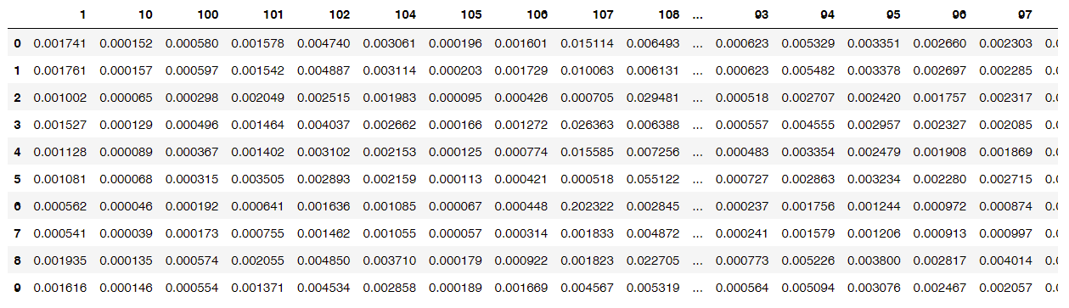
Method
Step1: Use gravity model to estimate number of customers of each shopping mall
Area/location value of malls
input
Huff
Model
output
Matrix of customer share from each neighborhood and for each target shopping center
Population by neighborhood
Road network
Part of Gravity model results
Note: Columns represent each neighborhood, row index is the ID of each shopping center

Slide 8
Method
Step2: Calculate annual cost and income using real estate financial formulas
Number of Customers
Building Area
Annual Consumption
Operation Expense per Square Meter
Market Penetration Rate
input
input
Income
Formula
Operating Income –Operating expenses
=NOI(Net Operation Income)
Cost
Formula
If NOI<=0, the shopping center is labeled with high operating loss risk(1)
Otherwise, it’s classified as low operating loss risk(0)
output
Number of identified malls (X)
Two lists of malls with high and low risk
Notes:
With the number of customers calculated by the gravity model, I use real estate financial formulas to calculate NOI, which is annual Net Operation Income of each shopping center. If NOI is below 0, the shopping center is labeled with high operating loss risk.

Slide 9
Method
Step3: Test the accuracy using actual operating data from social media
Average consumption*Number of comments
Building area
Operating
Metric
Subset [X] number of malls with smallest index as high operating loss risk
output
List of malls with high risk
List of malls with low risk
Compare with
Model classification result
output
Accuracy

Slide 10
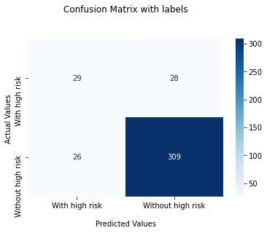
Results
The overall accuracy is good but the model still has improvement space
 | Accuracy
Overall | 86.22%
High operating loss risk | 50.87%
Low operating loss risk | 92.24%
57 out of 392 shopping centers
Notes:
The model identified 57 shopping centers with high risk out of almost 400, which accounts for 15 percent. Seeing from the confusion matrix, the overall accuracy is 86%. Since input data is before 2020 and accuracy test data is up to data. It seems that the model could predict loss risk before the construction of a new project. However, it has limited accuracy to identify shopping centers with high loss risk.

Slide 11
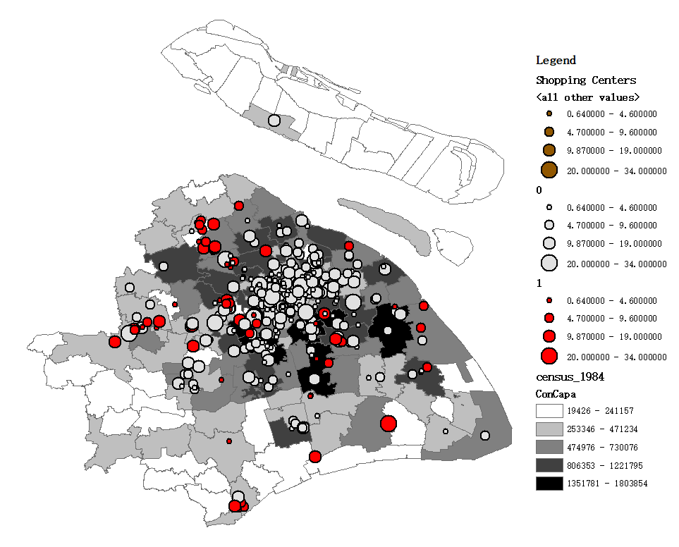
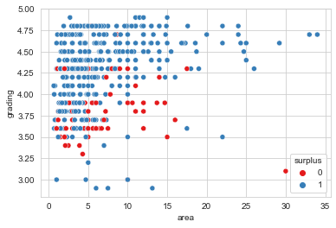
Results
Identified malls locate at suburbs where consumption capacity is small
Malls with high loss risk are mostly located in suburban areas where the aggregated consumption capacity is small.
Others are located in the urban center periphery where the market is competitive.
Shopping center area
High loss risk
Area and customer grading distribution of identified malls
Low loss risk
Consumption Capacity

Slide 12
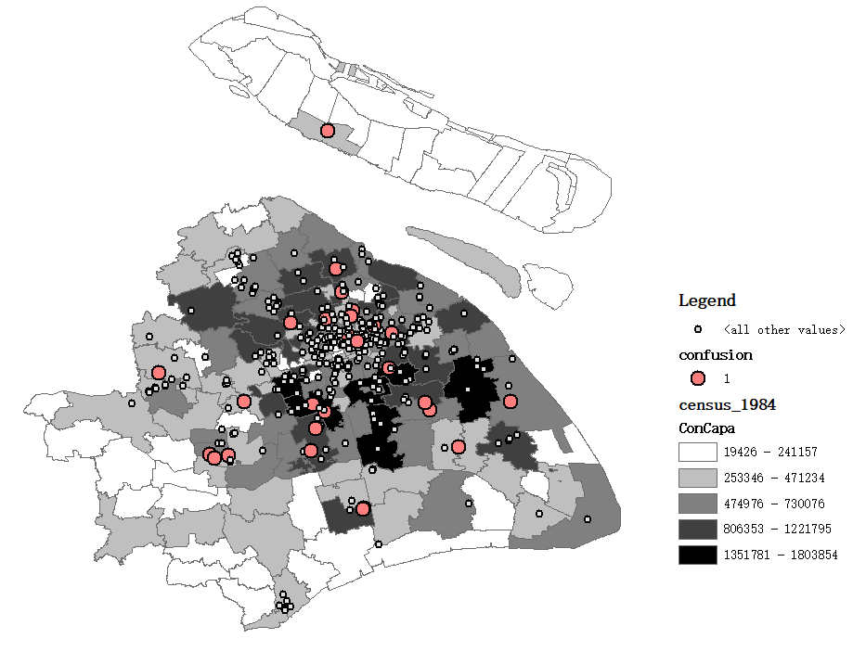
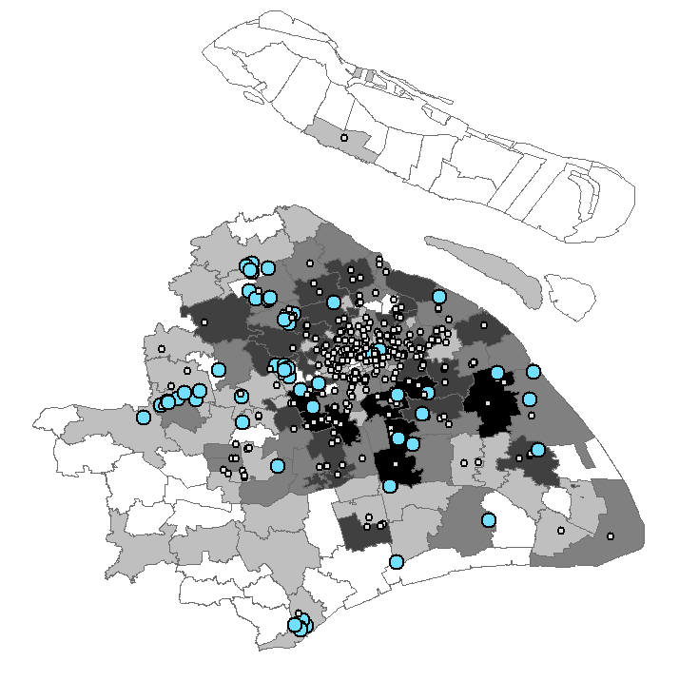
Error Distribution
The model considers spatial and social factors but ignores management influence
True Negative
With high loss risk but predicted as with low risk.
Errors are predominately in neighborhoods with
high consumption capacities.
False Positive
With low loss risk but predicted as with high risk
Errors cluster in suburban neighborhoods where consumption capacities is smaller
Notes:
As we can see true-negative mistakes cluster in rich neighborhoods, while false-positive mistakes cluster in suburban communities where income is lower. This is because the model considers spatial and social factors but ignores management influence. Some malls have a good location but still face the closing risk due to poor management capability.

Slide 13
Goal 2
Analyzing mismatch of operation and location value
Notes:
That’s why we need our second goal

Slide 14
Method
Step1: Quantify location value using entropy weighted methods
Transportation
Categories | Primary Weight | Factors | Entropy Weight
Transportation | 0.3 | Subway | 0.22
 |  | Road density | 0.08
Amenity | 0.2 | Urban parks | 0.09
 |  | Attractions | 0.06
 |  | University City | 0.05
Demographic | 0.2 | Population | 0.18
 |  | Consumption | 0.02
Competition | 0.3 | Competitive intensity | 0.13
 |  | Competitiveness | 0.17
Amenity
input
EWM
output
Secondary Weight
output
Location
Value
Demographic
Competition
Categories | Factors | Description
Transportation | Subway | Distance to nearest subway station
 | Road density | Distance to 5 nearest crossroads
Amenity | Urban parks | Distance to nearest parks
 | Attractions | Distance to 3 nearest attractions
 | University City | Distance to nearest university city
Demographic | Population | Population density of neighborhood
 | Consumption | Average annual consumption
Competition | Competitive intensity | Number of comparable shopping centers in 3km
 | Competitiveness | Area of the shopping center divided by total area of the
 |  | Competitiors within 3 kilometers
Notes:
I made a summary of relevant research and calculate the location value considering the perspective of transportation, amenity demographic, and competition. The entropy weight method calculates weight based on the variance of data. It avoids subjective grading.

Slide 15
Method
Step2: Build a regression model using operation and location value
Notes:
Then I built a regression model using location and operation value. I was frustrated when I first saw the result. Because there seems no correlation between the two variables.

Slide 16
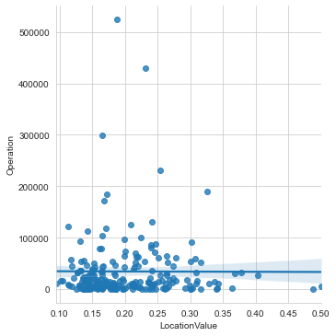
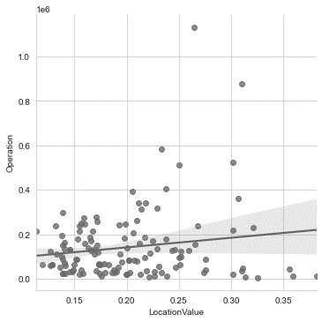
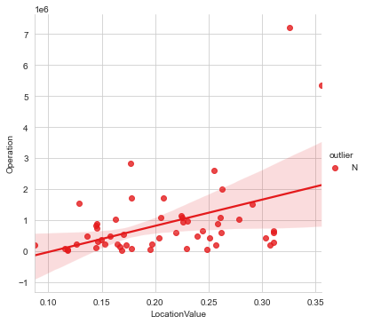
Method
Step3: Split the data by the class of malls and rebuild the regression
Class | Average Consumption(RMB)
High-end malls | 0<=X<200
Mid-end malls | 200<=X<400
Low-end malls | X>400
Low-end malls
Mid-end malls
High-end malls
r=0
r=0.158
r=0.435
Notes:
However, things got interesting after I split the data by the class of malls. For high-end malls, the operation value is highly correlated with location, And for the low-end malls, the location seems not that important.

Slide 17
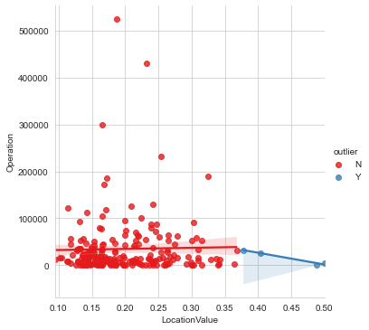
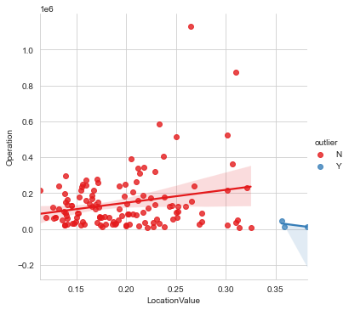
Method
Step4: Detecting outliers under the regression line
Calculate the residuals of regression result
Input
Yes
Ɛ>2.5 standard deviations from the mean
No
Normal
Outlier
Low-end malls
Mid-end malls
High-end malls
r=0
r=0.158
r=0.435
Notes:
Then I try to identify outliers under the regression line, which are shopping centers with high location value but low operation value. The residual of outliers is greater than 2.5 standard deviations from the mean. 7 outliers are identified in total.

Slide 18
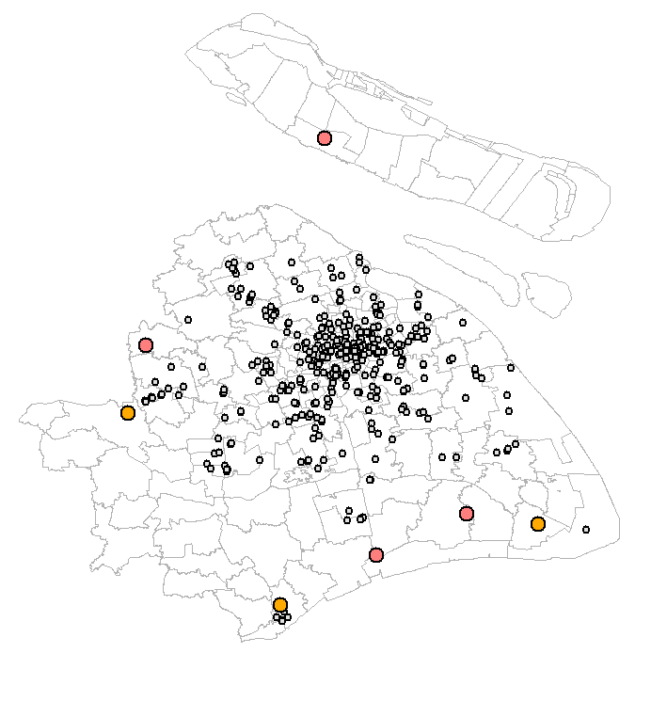
Redevelopment Strategies
Based on the current level and competing environment
With Competitors
Disposition
Building redevelopment
Anchor tenant improvement
Interior redevelopment
1
4
2
3
Low-end
Mid-end
2
1
7
3
6
5
6
Retarget customer group
Interior redevelopment
Operation improvement
7
5
4
Without
Competitors
Notes:
I came up with some redevelopment strategies based on the mall level and competing environment. For the mid-end malls with surrounding competitors, they could improve the anchor tenant and redevelop the interior. For the low-end malls with surrounding competitors, they could consider disposition or change the building function.

Slide 19
Discussion
Findings
1) Find out 57 malls with high operating loss risk and 7 malls with redevelopment value.
2) Accuracy of the model is 86.22%.
Limitation
1) The model considers spatial and social factors but ignores the influence of management. There is a bias toward the malls located in the rich and poor communities.
2) Impact of the pandemic is not considered in this model. In fact, there could be more than 57 shopping centers facing closing risk.
Notes:
. I didn’t find a valid dataset and methods to quantify the effects.

Slide 20
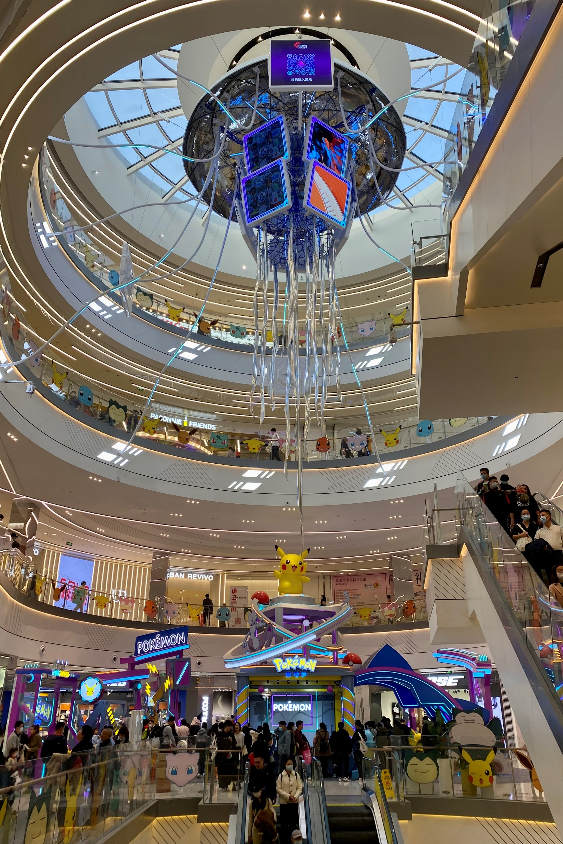
Thank you!
Q&A

